Slide 1
Wi-Fi CSI Presence Sensing
Weekly progress — what a single ESP32 can and cannot do
Dylan Dhawan • June 25, 2026

Slide 2
Goal & What is CSI
The goal
What is CSI?
• Turn ordinary Wi-Fi into a presence / motion sensor — no cameras or wearables.
• Roadmap: presence → activity → people-counting → coarse localization.
• Master 1 ESP link first, then scale to 2 and 3.
• Build methods that can transfer to better radios later.
• Wi-Fi (20 MHz) splits into 64 subcarriers via OFDM (~52 usable).
• Each packet → the channel measured per subcarrier (amplitude + phase).
• That matrix is the Channel State Information (CSI).
• Far richer than RSSI (a single signal-strength number).
• The ESP32-C3 exposes raw CSI — a ~$5 chip becomes a sensor.

Slide 3
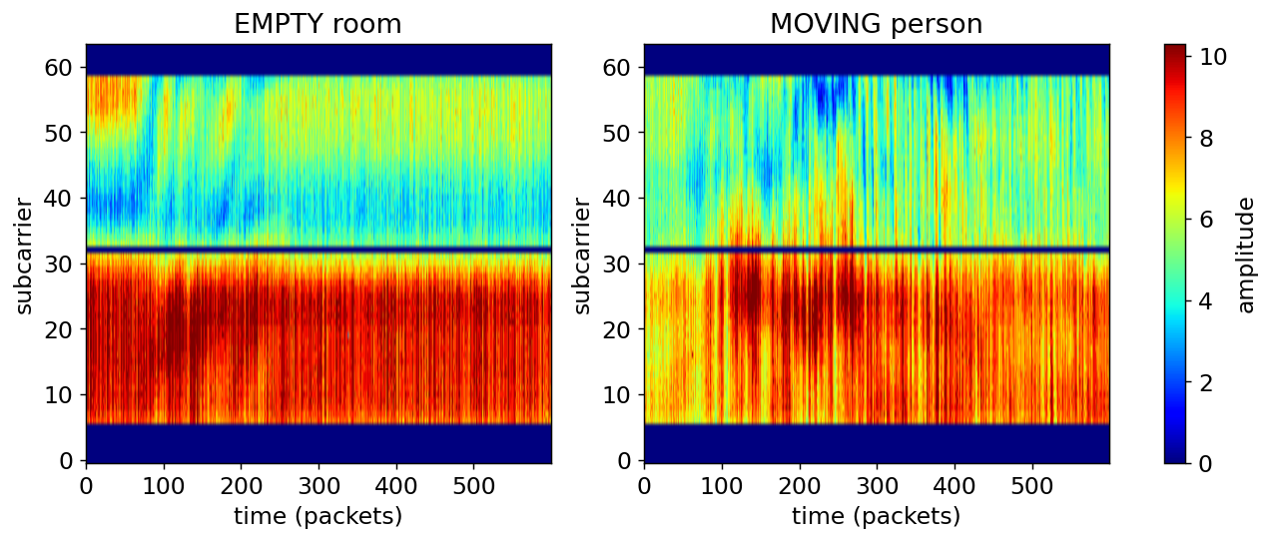
How we read information from CSI
Wi-Fi reflects off walls, furniture, and bodies (multipath). A static room gives stable CSI; a person or motion constantly changes it. We sample CSI ~100x/sec and analyze the change over time. Left: empty room (stable bands). Right: a moving person (rapid changes / Doppler ripples).

Slide 4
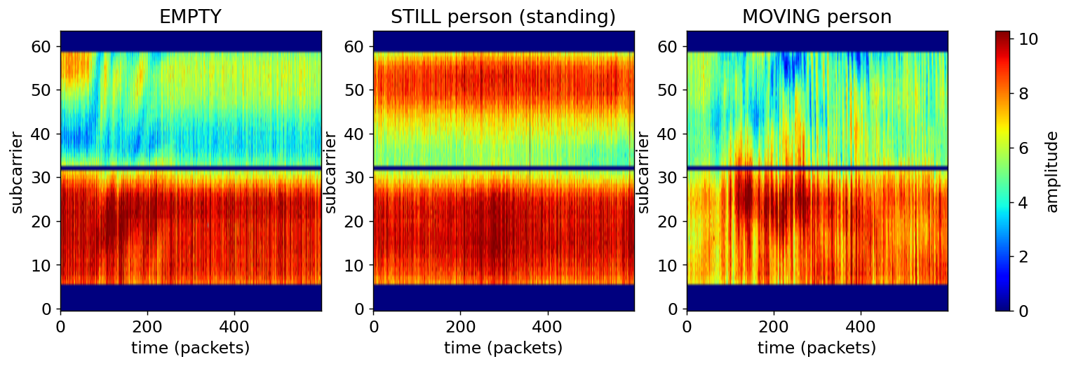
Telling actions apart in the CSI
Empty = stable. A still, standing person = a subtle change — the model relies on small, slow fluctuations rather than obvious motion. Moving = large, rapid, broadband changes. These differences are what the model learns to separate.

Slide 5
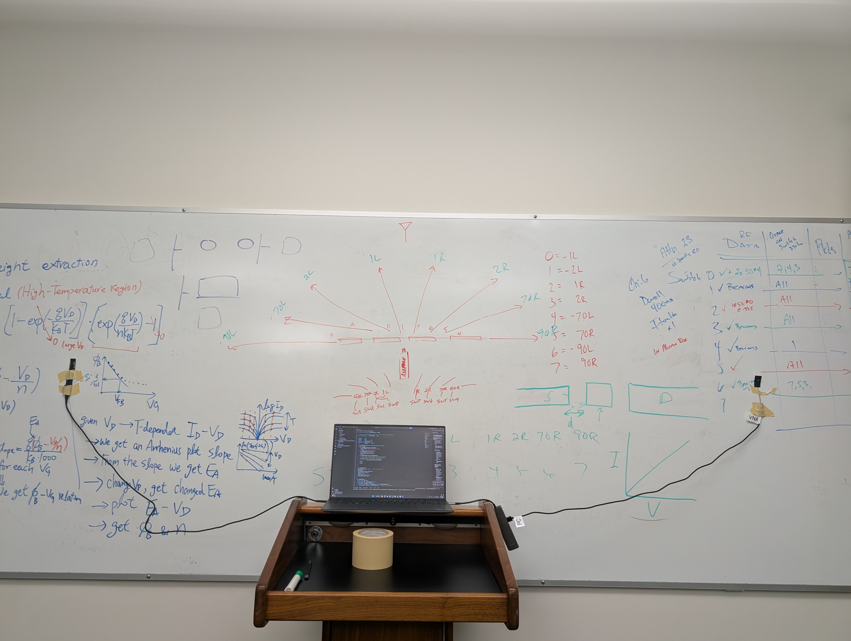
Our Setup & Data Collection
• 2x Seeed XIAO ESP32-C3 (2.4 GHz, 20 MHz): one transmits, one receives — a single Wi-Fi link.
• Custom firmware: fixed channel, MAC-filtered, steady 100 Hz; 0 dropped packets to the laptop.
• A webcam records alongside the CSI, time-stamped on the same clock.
• Pose estimation (Ultralytics YOLO11-pose, COCO-pretrained) auto-labels each moment empty / still / moving.
• Result: thousands of time-aligned, labeled CSI windows with almost no manual effort.
• Tested across 3 link placements in one conference room.
TX and RX boards on the wall; laptop logs CSI between them.

Slide 6
The model & how we train it
• CSI is sliced into 2-second windows (~200 samples x 52 subcarriers).
• Features per window: amplitude variability (motion), deviation from an “empty” baseline (presence), and low-frequency fluctuation energy 0.15-0.5 Hz (helps catch still occupants).
• Per-setup calibration: record a few seconds of empty at install, then subtract & scale-normalize — this is what lets one model work across different placements.
• Classifier: Random Forest — robust on modest data and interpretable.
• Validation: train on some setups, test on a completely unseen one (leave-one-out) — measures real-world generalization, not memorization of one room.
CSI stream @ 100 Hz
→
2-second windows
→
Features: motion, low-freq, empty-deviation
→
Per-setup calibration
→
Random Forest → empty / still / moving

Slide 7
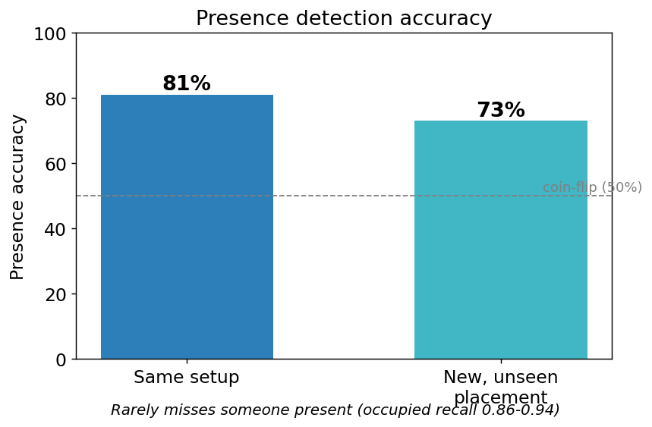
What 1 ESP is good at
• Reliable presence detection — including a still, standing person (no movement required).
• ~81% accuracy when tested within a setup it trained on.
• ~73% on a brand-new link placement, after a quick empty-room calibration.
• Very high “someone is here” recall — rarely misses an occupant.
• Generalizes across placements once calibrated — a key step toward portability.

Slide 8
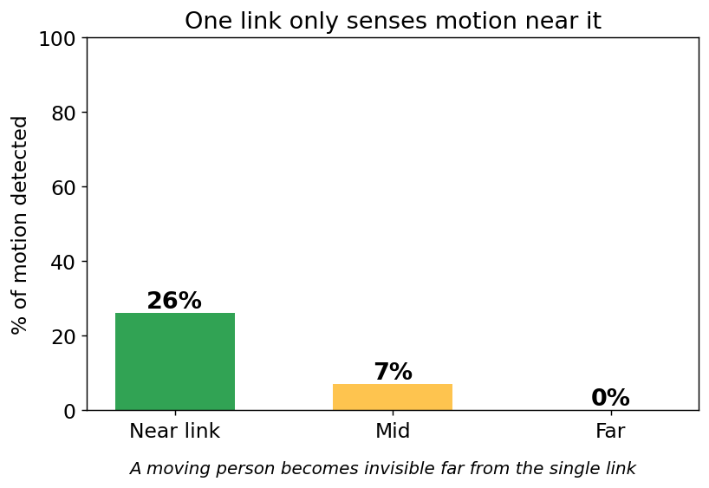
Where 1 ESP falls flat
• Motion is only sensed near the link — detection drops to ~0% as a person moves away.
• Distinguishing motion far from the link is unreliable (the radio simply doesn’t “see” it).
• People-counting and precise location are not dependable with a single link.
• One link covers only a slice of the room — large blind spots remain.

Slide 9
Why more ESPs — and what's next
Why we need more ESPs
Next steps
• Each link covers a different region; together they fill each other’s blind spots.
• Fusing 2-3 links → whole-room motion & position coverage, people counting, robustness.
• Coverage data is the concrete evidence: one link physically cannot cover the room.
• More viewpoints also stabilize presence accuracy across the space.
• Add the 2nd ESP; directly measure the coverage / accuracy gain.
• More setups + a cleaner generalization test to firm up the ~73% cross-placement number.
• Begin fusing multiple links; explore people-counting and coarse localization.
• Short methodology write-up: capture → auto-labeling → calibration recipe.

Slide 10
Appendix
Backup detail — pull up only if asked

Slide 11
Appendix — Model & training details
• Trained on 12 sessions (~35-40 min of CSI) → ~1,900 labeled 2-second windows.
• 3 link placements, one conference room, one person; labels auto-generated by webcam + YOLO-pose.
• Features per window: amplitude variability (motion), deviation from an empty baseline (presence), low-frequency energy 0.15-0.5 Hz, and a per-setup calibration.
• Classifier: Random Forest (400 trees) — strong on modest tabular data, interpretable, no scaling needed.
• Validation: leave-one-out; hardest test trains on 2 placements and tests on a brand-new 3rd.
• To try later: gradient boosting (XGBoost/LightGBM); CNN/LSTM with much more data.

Slide 12
Appendix — Accuracy & stats
 | Same setup | New placement
Presence accuracy | 81% | 73%
Occupied recall (catches a person) | 0.94 | 0.86
Empty recall | 0.61 | 0.53
Balanced accuracy | 0.77 | 0.70
• 3-class (empty / still / moving): ~61-67%.
• Motion (moving vs. still): weak (~0.2-0.4 recall); ~0% far from the link.
• A naive random-split test would read ~99% (memorizes the room) — we report held-out numbers.
• Model leans cautious: rarely misses a person, more likely to false-alarm an empty room.

Slide 13
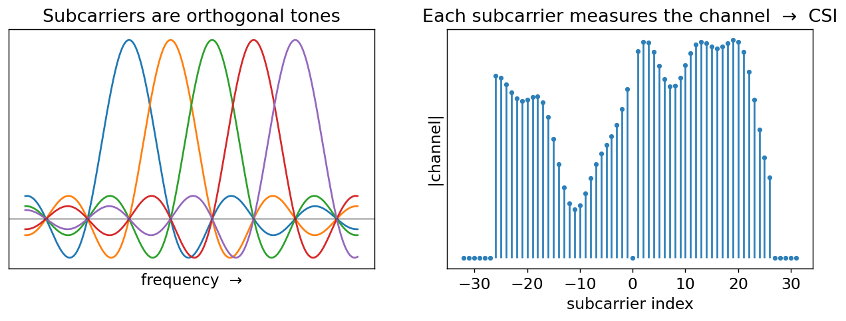
Appendix — OFDM, the basis of CSI
• Wi-Fi splits its 20 MHz channel into 64 subcarriers (~52 usable), sent in parallel — that is OFDM.
• “Orthogonal” = the tones are spaced so they don’t interfere (each peak sits on its neighbours’ zeros).
• The receiver measures the channel at each subcarrier → those ~52 values ARE the CSI (vs. RSSI’s one number).

Slide 14
Appendix — External datasets & models
• Public CSI datasets exist: Widar3.0, SignFi, UT-HAR, FallDeFi, WiAR.
• Caveat: mostly different hardware (e.g. Intel 5300: 30 subcarriers, 3 antennas) and rooms — CSI is hardware- and environment-specific.
• We showed our own model breaks just by moving the link, so external data won’t directly raise our ESP32 accuracy.
• Useful for: feature/architecture ideas, benchmarking, and later transfer-learning — not plug-and-play.
• No good drop-in pretrained CSI model for ESP32; the value online is in methods, not weights.

